Slide 1
Ukko
A Simple Weather App
Force-Pushed to you by Kevin Welsh

Slide 2
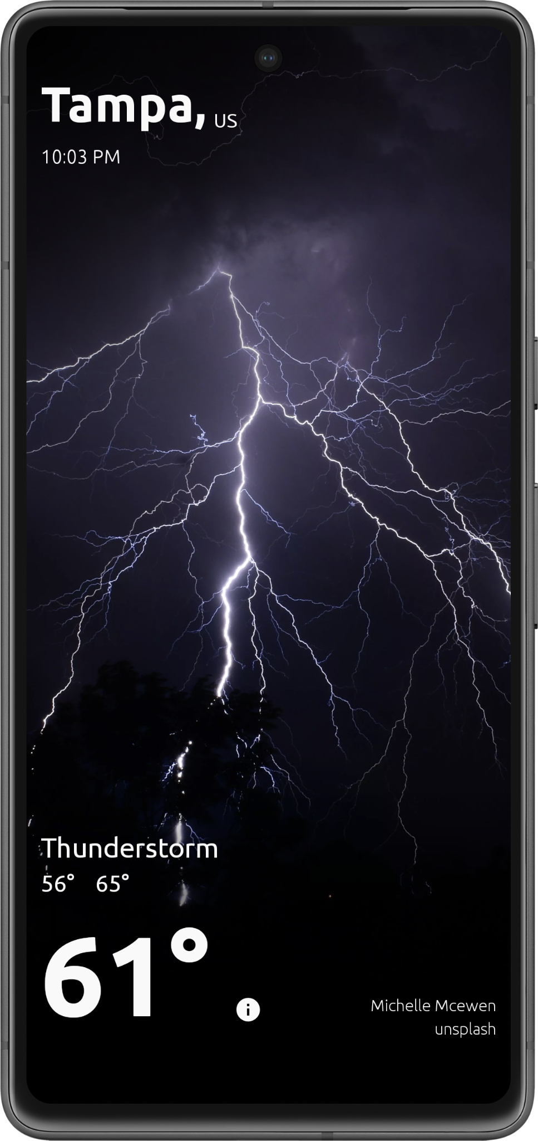
Because two screens is one too many
Initially started as a basic coding assessment, Ukko evolved to be a playground for trying out new libraries such as Ktor & Koin. It is now attempting to morph into a Kotlin Multiplatform app.

Slide 3


Past
Ukko started life as a simple app to demonstrate best practices using the standard pillars of Android development.
Kotlin + Fragments Sprinkling in coroutines, databinding, and LiveData.
RetroFit & Hilt Networking & Dependency Injection libraries everyone has been using for years.
MVVM Keeping the architecture clean & modular

Slide 4
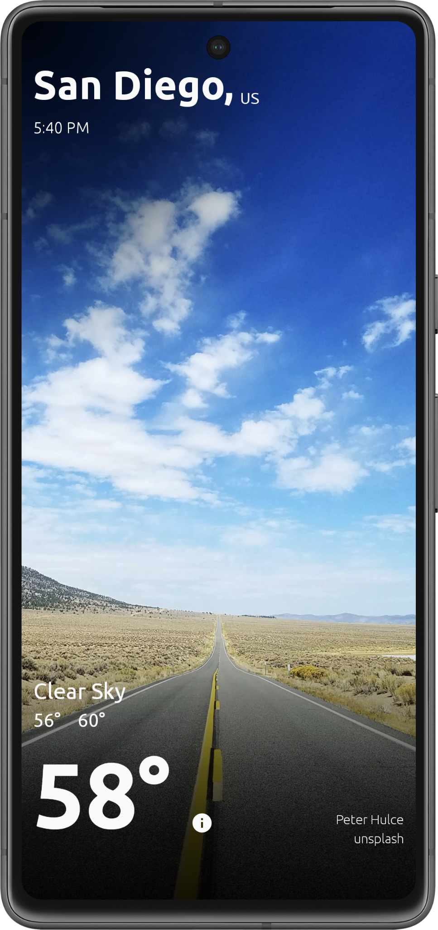
Problem?
If you constantly use only the same libraries & techniques, how will you ever gain exposure to the latest technologies???
Tip
Don’t wait for a stable release to try out a library.
Good Open Source devs welcome feedback, even if it’s something as simple as a bug report!

Slide 5
Present
Ukko has become a playground for testing technologies & ideas
KMP Write once, run everywhere?
Koin & Ktor A simpler solution to your Dependency Injection & networking needs.
MVI? MVVM + Repos? To be able to share business logic across platforms, we need a nimble, modular architecture.

Slide 6

Kotlin Multiplatform
In order to fully take advantage of sharing code across platforms, we should pick libraries that make that goal easy.
Out: Hilt, RetroFit, Android Compose
In: Koin, Ktor, Kotlin Compose
Tip
It doesn’t matter what your tech stack is if it’s cluttered & unorganized. MVVM, MVI, MVP, VIPER…just pick one you can stick to!

Slide 7
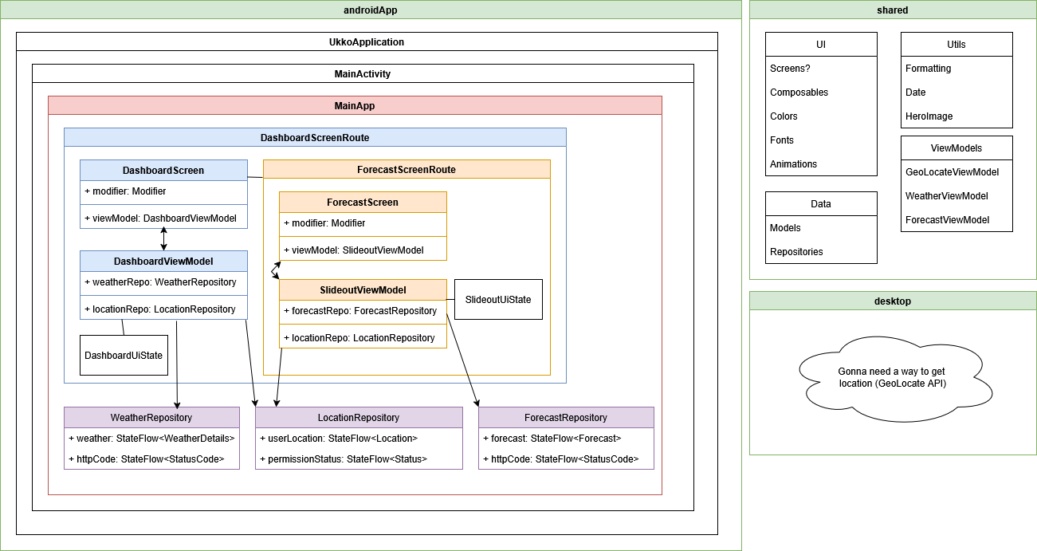
Fun UML Diagram
(forgive the sloppiness)

Slide 8


Future
What now???

Slide 9

To-Do List
Finish migrating code to shared module
Make Forecast view pretty
Loading/Error use cases
Experiments! Live Notifications, alternative Weather APIs, Caching, Desktop builds…
Tip
A good ReadMe is vital to a project!
Nobody will contribute to a codebase if they can’t be onboarded easily.

Slide 10
Closing
Upskill Open your mind to new technologies & programming paradigms.
ABC Always Be Coding - complacency doesn’t look good on anyone!
Yawn -> Yay! Even a boring app can be made to feel fresh when you have the courage to step outside your comfort zone.

